Slide 1





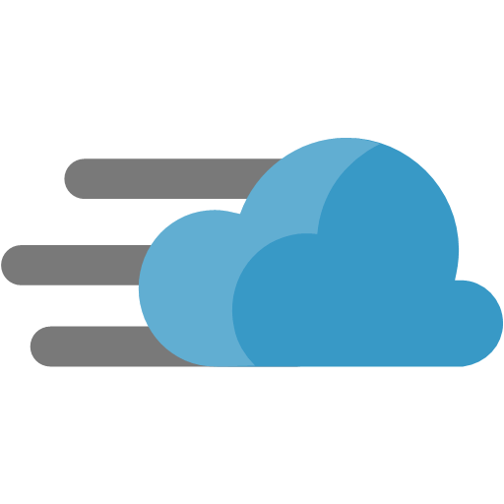

Common scenarios
Azure Infrastructure as a Service (IaaS)
Virtual Machines
Virtual Network
Jenkins (Image Gallery)
Load Balancers
Traffic Manager
Content Delivery Network
Storage
Notes:
In the following slides, we will touch on some Azure technologies that can and should be leveraged when thinking about the solution. In the corresponding Case Study document, you will also find links that elaborate even further on these topics.
In this slide we call out Azure infrastructure as a service (or IaaS) components – Virtual Machines & Virtual Networking (highlighting a couple of ways to connect to the Azure cloud – by way of a Site to Site Connection or a Point to Site connection)

Slide 2
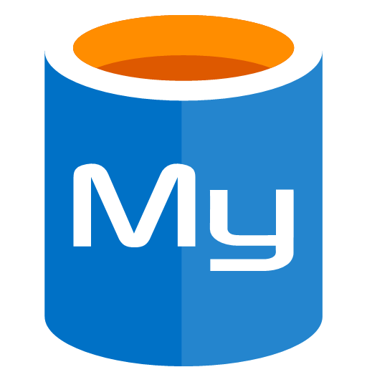

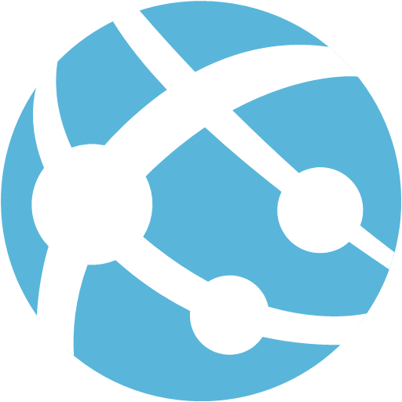

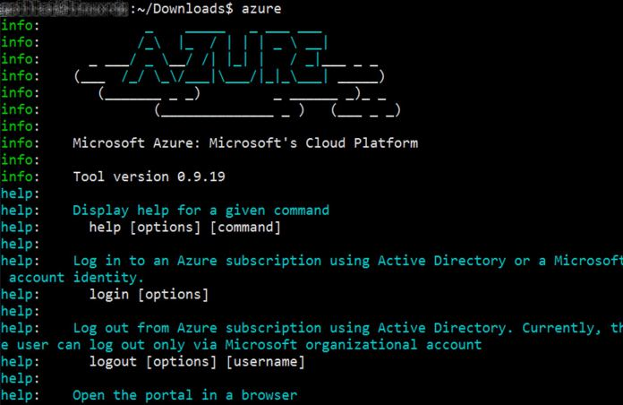

Common scenarios
Azure Platform as a Service (PaaS)
Azure Database for MySQL
App Service for Linux
Web Apps
Autoscaling
Additional Tools
Eclipse IDE
Azure Command Line Interface
Notes:
In the following slides, we will touch on some Azure technologies that can and should be leveraged when thinking about the solution. In the corresponding Case Study document, you will also find links that elaborate even further on these topics.
In this slide we call out Azure infrastructure as a service (or IaaS) components – Virtual Machines & Virtual Networking (highlighting a couple of ways to connect to the Azure cloud – by way of a Site to Site Connection or a Point to Site connection)

Slide 3









Preferred solution
App Service for Linux
Azure
Hong Kong SAR
static files
Content
Delivery
Network
Autoscaling
Asia
Customer’s
Browser
www.treyvitamins.com
Configured for Geo-restore
trey.trafficmanager.net
Azure
North Europe
DNS C Record Points to Traffic Manager
Europe
Traffic Manager
Customer’s
Browser
static files
Content
Delivery
Network
Azure Managed Load Balancer
CORP
Azure Database
for MySQL
Web
Server
MySQL
Server
AD
Back Office
Servers
GitHub
Enterprise
Jenkins
Master
Build Nodes
VPN

Slide 4
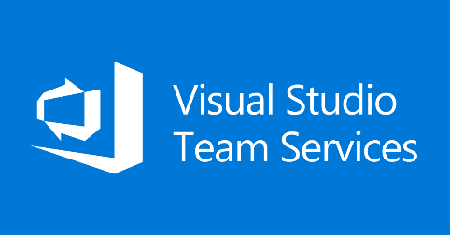
Additional solution
App Service for Linux
Azure
Hong Kong SAR
static files
Content
Delivery
Network
Autoscaling
Asia
Customer’s
Browser
www.treyvitamins.com
Configured for Geo-restore
trey.trafficmanager.net
Azure
North Europe
DNS C Record Points to Traffic Manager
Europe
Traffic Manager
Customer’s
Browser
static files
Content
Delivery
Network
Azure Managed Load Balancer
CORP
Azure Database
for MySQL
Web
Server
MySQL
Server
AD
Back Office
Servers
GitHub
Enterprise
VPN
Visual Studio Team Services
Notes:
This is an additional solution that simplifies the Azure environment by integrating (or completely replacing) the Jenkins infrastructure with Visual Studio Team Services, thereby reducing the management overhead since there would be no servers to manage in this solution.
Visual Studio Team Services Integration with Jenkins
VSTS includes a growing list of preinstalled configurations. One of its integrations is with Jenkins. This allows using both CI systems with traceability through a single platform. Some example scenarios include:
Using Jenkins for continuous integration of Team Services Git repositories
Using Jenkins to validate Team Service pull requests
Mixing Jenkins and Team Services to perform builds and releases
Providing traceability between Jenkins and Team Services; linking builds, pull requests, commits, and stories
There are multiple ways to use Jenkins as a CI server with Team Services. Jenkins’ built-in Git Plugin can poll a VSTS repository every few minutes and queue a job when changes are detected. For those who need a tighter integration, VSTS provides two additional ways to achieve it: 1) the Jenkins Service Hook, and 2) Jenkins build and release tasks.
The Jenkins Service Hook in VSTS automatically queues a Jenkins job when code changes are pushed to your repository. This is an improvement over polling because jobs are immediately queued.
VSTS adds capabilities over the Jenkins Service Hook by including connectors that allow its build and release systems to integrate with Jenkins. These connectors can be chosen from the list of tasks to execute as steps in a VSTS build or release definition.
In effect, a VSTS build or release will queue a Jenkins job and download resulting artifacts. The Jenkins Queue Job task queues a Jenkins job by name. It can wait for the job to complete or immediately continue to subsequent steps.
When the option is selected to capture the Jenkins job’s console output, it is displayed live in VSTS while the build executes. After the build completes, the console output is available in the VSTS logs.
Downstream jobs and multi-branch pipeline results are displayed in the Team Services Build or Release Summary for traceability.
The Jenkins Download Artifacts task makes it easy to download build artifacts from Jenkins and integrate them in your VSTS build or release process. Once artifacts are downloaded, they can be used by other tasks.
Jenkins can also independently trigger a VSTS release. You can configure the Jenkins post-build action named Trigger release in TFS / Team Services to initiate the release.
Then, you can set your VSTS release definition to use artifacts from the Jenkins build. Artifacts will be downloaded from Jenkins and used in your VSTS release pipeline.
Alternatively, you could simply replace your Jenkins installation and leverage the end-to-end features all within Visual Studio Team Services using the built in tasks to build and deploy the solution.

